Slide 1
《算法分析与设计》
Analysis and Design of Computer Algorithms
中南大学计算机学院
School of Computer Science and Engineering
Central South University
主讲：李敏
联系方式：limin@mail.csu.edu.cn
csu.limin@gmail.com
Notes:
Decrease and Conquer

Slide 2
Decrease and Conquer (减治法)
Basic idea for decrease and conquer
Fake-coin problem
Find the k-th smallest element
Insertion Sort
DFS&BFS
Topological sorting
Notes:
Decrease and Conquer

Slide 3
5.1 减治法的设计思想
规模为n的原问题的解与较小规模（通常是n/2）的子问题的解之间具有关系：
（1）原问题的解只存在于其中一个较小规模的子问题中；
（2）原问题的解与其中一个较小规模的解之间存在某种对应关系。
由于原问题的解与较小规模的子问题的解之间存在这种关系，所以，只需求解其中一个较小规模的子问题就可以得到原问题的解。
Central South University

Slide 4
A Typical Decrease by One Technique
a problem of size n
subproblem
of size n-1
a solution to the
subproblem
  e.g., n! =(n-1)!*n
a solution to
the original problem
Central South University

Slide 5
A Typical Decrease by a Constant Factor (half) Technique
a problem of size n
subproblem
of size n/2
a solution to the
subproblem
  e.g., Binary search
a solution to
the original problem
Central South University
Notes:
Decrease and Conquer

Slide 6
A Typical Divide and Conquer Technique
a problem of size n
subproblem 1
of size n/2
subproblem 2
of size n/2
a solution to
subproblem 1
a solution to
subproblem 2
  e.g., mergesort
a solution to
the original problem
Central South University

Slide 7
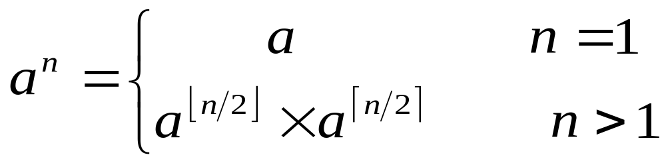
例：计算a^{n}的值，应用减治技术得到如下计算方法：
⎧
a
n
=
1
⎪
O (log₂n)
a
n
=
⎨
(
a
n
2
)
2
n
>
1
且是偶数
⎪
(
a
(
n
−
1
)
2
)
2
×
>
⎩
a
n
1
且是奇数
应用分治法得到a^{n}的计算方法是：
O (nlog₂n)
Central South University

Slide 8
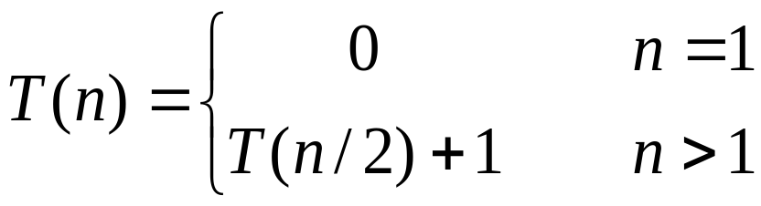
减治法只对一个子问题求解，并且不需要进行解的合并。应用减治法（例如减半法）得到的算法通常具有如下递推式：
所以，通常来说，应用减治法处理问题的效率是很高的，一般是O(log₂n)数量级。
Central South University

Slide 9
减治法有三种变种
  减去一个常量
  例如减一法
  计算a^{n}的值: a^{n}= a^{n-1} * a
  减去一个常数因子
  例如减半思想
  计算a^{n}的值
  减去的规模是可变的
  算法在每次迭代时 规模减小的模式不同。
  例如：计算最大公约数的欧几里得算法
  gcd(m,n)=gcd(n,m mod n)
⎧
a
n
=
1
⎪
a
n
=
⎨
(
a
n
2
)
2
n
>
1
且是偶数
⎪
(
a
(
n
−
1
)
2
)
2
×
>
⎩
a
n
1
且是奇数
Central South University

Slide 10
Decrease-by-a-Constant-Factor Algorithm (It’s very fast, do not happen often!)
Fake-coin problem
  Among n identically looking coins,one is fake.
  Assume that it is known whether the fake coin is lighter or heavier than the genuine one –We assume that the fake coin is lighter.
Solution:
  Divide n coins into two piles of [n/2] coins each, leaving one extra coin apart if n is odd,
  put the two piles on the scale. If the piles weigh the same, the coin put aside must be fake;
  otherwise ,we can proceed in the same manner with the divide the coins into two subsets.
  W (n)=W(n/2)+ 1 for n>1,W(1)=0
  So W(n )=log₂n
Central South University

Slide 11
The algorithm is not the most efficient solution!
  Dividing the coins into three piles about n/3 coins each.
  After weighing two of the piles,we can reduce the instance size by a factor of three.
W (n)=W(n/3)+ 1 for n>1,W(1)=0
So W(n )=log₃n
Central South University

Slide 12
Find the k-th smallest element
Problem:
Given n elements saved in a[](all elements are different), an integer k, 1≤k ≤ n, find the k-th smallest element in a[] in O(n) time.
If a[] is sorted, a[k-1] is the k-th element.
Central South University

Slide 13
Find the k-th smallest element
Borrow ideas from Quicksort.
Partition:
Partition the array into two subarrays around a pivot x such that the elements in lower subarray ≤ x ≤ elements in upper subarray.
Find the k-th smallest value
Partition
Central South University

Slide 14
Find kth smallest element based on Quicksort
Findkelement(A, p, q, k)
if (p = q) return a[p];
r = Partition(A, p, q);
j=r-p+1;
if k≤j return Findkelemnt(A, p, j, k)；
else
return Findkelemnt(A, j+1, q, k-j)；
Central South University

Slide 15
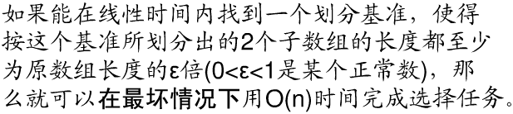
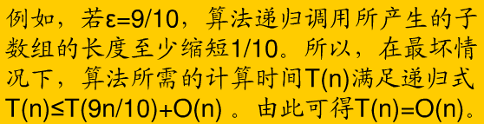
Find kth smallest element based on Quicksort
Worst case complexity: O(n²)
Our objective: the worst case running time is still O(n).
Central South University

Slide 16

Find kth smallest element
Strategy:
(1) Divide the elements in a[] into groups.
(2) Sort each group with any arbitrary sorting algorithm.
(3) For each group, find the median element. Then, there are totally median elements.
(4) Denote the set of median elements found by M, |M|= . Recursively find the median elements of M, denoted by x.
(5) Partition with pivot x.
Central South University

Slide 17
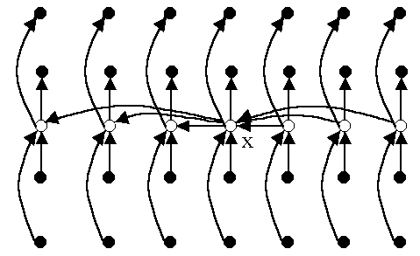
Find kth smallest element
How to get the recursive relation?
How many elements are less than pivot x?
(1) In each group , there are two elements less than the median of this group;
(2) How many are less than x?
There are at least 3 n/10 elements that are less than pivot x.
Central South University

Slide 18
Find kth smallest element
Select(a[],k) //T(n)
1. if size of a[] is less than 10, sort [] using any sorting algorithm;
2. Divide a[] into M=⎣n/5⎦ groups, each of which has size 5;
3. Find the median of each group and denote the set of medians by M;
4．x←Select(M,⎡|M|/2⎤); //T(n/5)
5．Compare the elements of a[] with x;
Let S1 be the set of elements less than x, and
let S2 be the set of elements larger than x;
6．if k ≤ |S1| then Select(S1,k) //T(|S1|)
7．else Select(S2,k-|S1|); //T(|S2|)
Central South University

Slide 19
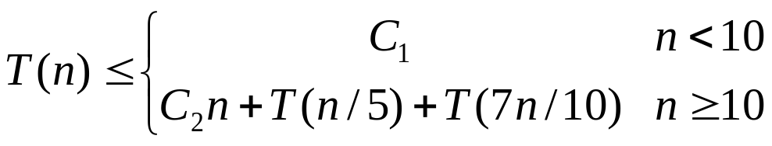
Find kth smallest element
T(n)=O(n)
Group size 5 and 10 is the critical point for recursion.
n/5+7n/10=9n/10=εn，0<ε<1
Besides 5 and 10, there are many other options.
Central South University

Slide 20
Insertion Sort
A decrease by one algorithm
  A Bottom-Up (iterative) solution
  A Top-Down (recursive) solution
Central South University

Slide 21
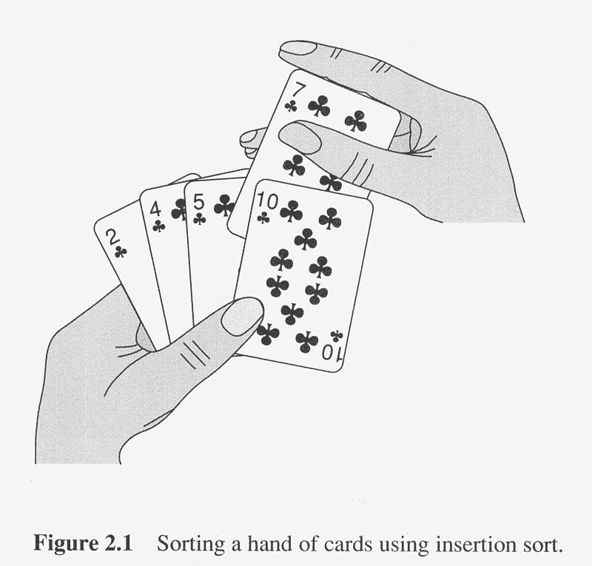
Insertion sort
Idea: by induction(Bottom-Up)
Central South University
Notes:
Decrease and Conquer

Slide 22
Insertion Sort: an Iterative Solution
ALGORITHM InsertionSortIter (A[0..n-1])
for i ← 1 to n – 1 do
key = A[i]
for j ← i – 1 to 0 do
if (A[j]>key)
A[j+1] ← A[j]；j ←j-1；
else
break
A[j +1] ← key //insert the key to the sorted part of the array
Central South University
Notes:
Decrease and Conquer

Slide 23
Insertion Sort: a Recursive Solution
ALGORITHM InsertionSortRecur(A[0..n-1], n-1)
if n > 1
InsertionSortRecur(A[0..n-1], n-2)
Insert(A[0..n-1], n-1) //insert A[n-1] to A[0..n-2]
ALGORITHM Insert(A[0..m], m)
//Insert A[m] to the sorted subarray A[0..m-1]
key = A[m]
for j ← m – 1 to 0 do
if (A[j]>key)
A[j+1] ← A[j]
else
break
A[j +1] ← key
Index of the last element
Central South University

Slide 24
Exercises
1.Design a recursive decrease-by-one algorithm for finding the position of the largest element in an array of n real numbers.
Algorithm LargestLocation(A[0..n-1])
    if n=1 return 0
    else temp=LargestLocation(A[0..n-2])
    if A[temp]>A[n-1] return temp
    else return n-1
2. Determine the time efficiency of this algorithm.
Central South University

Slide 25
Graph Traversal
Graph traversal algorithms:
  Depth-first search
  Breadth-first search
Central South University
Notes:
Decrease and Conquer

Slide 26
Some Terminologies
Vertices and Edges
Undirected and directed graphs
Parents, children, and ancestors.
Connected graphs
  A graph is said to be connected if for every pair of its vertices u and v there is a path from u to v.
Central South University
Notes:
Decrease and Conquer

Slide 27
Graph Representation
Adjacency matrix
  n x n boolean matrix if |V| is n.
  It takes (comparisons) to figure out all the adjacent nodes of a certain node i.
Adjacency linked lists
  A collection of linked lists, one for each vertex, that contain all the vertices adjacent to the list’s vertex.
|V|
Central South University
Notes:
Decrease and Conquer

Slide 28
Depth-first search
The idea
  traverse “deeper” whenever possible.（走迷宫模式）
  On each iteration, the algorithm proceeds to an unvisited vertex that is adjacent to the one it is currently in.
  When reaching a dead end ( a vertex with no adjacent unvisited vertices), the algorithm backs up to the parent and tries to continue visiting unvisited vertices from there.
  The algorithm halts after backing up to the starting vertex, with it being a dead end.
Central South University
Notes:
Decrease and Conquer
走迷宫

Slide 29
Depth-first search
It’s convenient to use a stack to trace the operation of depth-first search.
  Push a vertex onto the stack when the vertex is reached for the first time.
  Vertices initially colored white
  Then colored gray when discovered
  Then black when finished
Central South University

Slide 30
DFS Example
source
vertex
Central South University

Slide 31
DFS Example
source
vertex
d f
1 |
|
|
|
|
|
|
|

Slide 32
DFS Example
source
vertex
d f
1 |
|
|
2 |
|
|
|
|

Slide 33
DFS Example
source
vertex
d f
1 |
|
|
2 |
|
3 |
|
|

Slide 34
DFS Example
source
vertex
d f
1 |
|
|
2 |
|
3 | 4
|
|

Slide 35
DFS Example
source
vertex
d f
1 |
|
|
2 |
|
3 | 4
5 |
|

Slide 36
DFS Example
source
vertex
d f
1 |
|
|
2 |
|
3 | 4
5 | 6
|

Slide 37
DFS Example
source
vertex
d f
1 |
8 |
|
2 | 7
|
3 | 4
5 | 6
|

Slide 38
DFS Example
source
vertex
d f
1 |
8 |
|
2 | 7
|
3 | 4
5 | 6
|

Slide 39
DFS Example
source
vertex
d f
1 |
8 |
|
2 | 7
9 |
3 | 4
5 | 6
|
What is the structure of the grey vertices?
What do they represent?

Slide 40
DFS Example
source
vertex
d f
1 |
8 |
|
2 | 7
9 |10
3 | 4
5 | 6
|

Slide 41
DFS Example
source
vertex
d f
1 |
8 |11
|
2 | 7
9 |10
3 | 4
5 | 6
|

Slide 42
DFS Example
source
vertex
d f
1 |12
8 |11
|
2 | 7
9 |10
3 | 4
5 | 6
|

Slide 43
DFS Example
source
vertex
d f
1 |12
8 |11
13|
2 | 7
9 |10
3 | 4
5 | 6
|

Slide 44
DFS Example
source
vertex
d f
1 |12
8 |11
13|
2 | 7
9 |10
3 | 4
5 | 6
14|

Slide 45
DFS Example
source
vertex
d f
1 |12
8 |11
13|
2 | 7
9 |10
3 | 4
5 | 6
14|15

Slide 46
DFS Example
source
vertex
d f
1 |12
8 |11
13|16
2 | 7
9 |10
3 | 4
5 | 6
14|15

Slide 47
Depth-First Search: The Code
DFS(G)
{
for each vertex u
{
u.color = WHITE;
}
time = 0;
for each vertex u
{
if (u.color == WHITE)
DFS_Visit(u);
}
}
DFS_Visit(u)
{
u.color = gray;
time = time+1;
u. d = time;
for each v ∈ u.Adj[]
{
if (v.color = = WHITE)
DFS_Visit(v);
}
u.color = black;
time = time+1;
u.f = time;
}

Slide 48
Depth-first search: Notes
DFS can be implemented with graphs represented as:
  Adjacency matrices: Θ(|V |²)
  Adjacency linked lists: Θ(|V |+|E| )
Applications:
  checking connectivity
  finding connected components
  Test if a graph has cycle.
  Others…..
Notes:
Decrease and Conquer

Slide 49
Breadth-first search (BFS)
The idea
  Traverse “wider” whenever possible.
  Discover all vertices at distance k from s (on level k) before discovering any vertices at distance k +1 (at level k+1)
Instead of a stack, breadth-first uses a queue.
Notes:
Decrease and Conquer

Slide 50
Breadth-First Search
“Explore” a graph, turning it into a tree
Builds a tree over the graph
  Pick a source vertex to be the root
  Find (“discover”) its children, then their children, etc.

Slide 51
Breadth-First Search
associate vertex “colors” to guide the algorithm
  White vertices have not been discovered
    All vertices start out white
  Grey vertices are discovered but not fully explored
    They may be adjacent to white vertices
  Black vertices are discovered and fully explored
    They are adjacent only to black and gray vertices
Explore vertices by scanning adjacency list of grey vertices

Slide 52
Breadth-First Search
BFS(G, s) {
initialize vertices;
Q = {s}; // Q is a queue ; initialize to s
while (Q not empty) {
u = RemoveTop(Q);
for each v ∈ u.adj {
if (v.color == WHITE)
v.color = GREY;
v.d = u.d + 1;
v.p = u;
Enqueue(Q, v);
}
u.color = BLACK;
}
}
What does v.d represent?
What does v.p represent?

Slide 53
Breadth-First Search: Example
r
s
t
u
∞
∞
∞
∞
∞
∞
∞
∞
v
w
x
y

Slide 54
Breadth-First Search: Example
r
s
t
u
∞
0
∞
∞
∞
∞
∞
∞
v
w
x
y
Q:
s

Slide 55
Breadth-First Search: Example
r
s
t
u
1
0
∞
∞
∞
1
∞
∞
v
w
x
y
Q:
w
r

Slide 56
Breadth-First Search: Example
r
s
t
u
1
0
2
∞
∞
1
2
∞
v
w
x
y
Q:
r
t
x

Slide 57
Breadth-First Search: Example
r
s
t
u
1
0
2
∞
2
1
2
∞
v
w
x
y
Q:
t
x
v

Slide 58
Breadth-First Search: Example
r
s
t
u
1
0
2
3
2
1
2
∞
v
w
x
y
Q:
x
v
u

Slide 59
Breadth-First Search: Example
r
s
t
u
1
0
2
3
2
1
2
3
v
w
x
y
Q:
v
u
y

Slide 60
Breadth-First Search: Example
r
s
t
u
1
0
2
3
2
1
2
3
v
w
x
y
Q:
u
y

Slide 61
Breadth-First Search: Example
r
s
t
u
1
0
2
3
2
1
2
3
v
w
x
y
Q:
y

Slide 62
Breadth-First Search: Example
r
s
t
u
1
0
2
3
2
1
2
3
v
w
x
y
Q:
Ø

Slide 63
BFS: The Code Again
BFS(G, s) {
initialize vertices;
Q = {s};
while (Q not empty) {
u = RemoveTop(Q);
for each v ∈ u.adj[] {
if (v.color == WHITE)
v.color = GREY;
v.d = u.d + 1;
v.p = u;
Enqueue(Q, v);
}
u.color = BLACK;
}
}
Touch every vertex: O(V)
u = every vertex, but only once
(Why?)
What will be the running time?
Total running time: O(V+E)

Slide 64
Breadth-First Search: Properties
BFS calculates the shortest-path distance to the source node
BFS builds breadth-first tree, in which paths to root represent shortest paths in G
  Thus can use BFS to calculate shortest path from one vertex to another in O(V+E) time

Slide 65
Breadth-first search: Notes
BFS has same efficiency as DFS and can be implemented with graphs represented as:
  Adjacency matrices: Θ(|V |²)
  Adjacency linked lists: Θ(|V |+|E| )
Applications:
  checking connectivity
  finding connected components
  finding paths between two vertices with the smallest number of edges
Notes:
Decrease and Conquer
Use a tree.

Slide 66
Topological Sorting
Problem: Given a Directed Acyclic Graph(DAG) G = (V, E), find a linear ordering of all its vertices such that if G contains an edge <u, v>, then u appears before v in the ordering.
Example: Give an order of the courses so that the prerequisites are met.
Question: Is the problem solvable if the digraph contains a cycle?
C4
C1
C3
C2
C5
Notes:
Decrease and Conquer

Slide 67
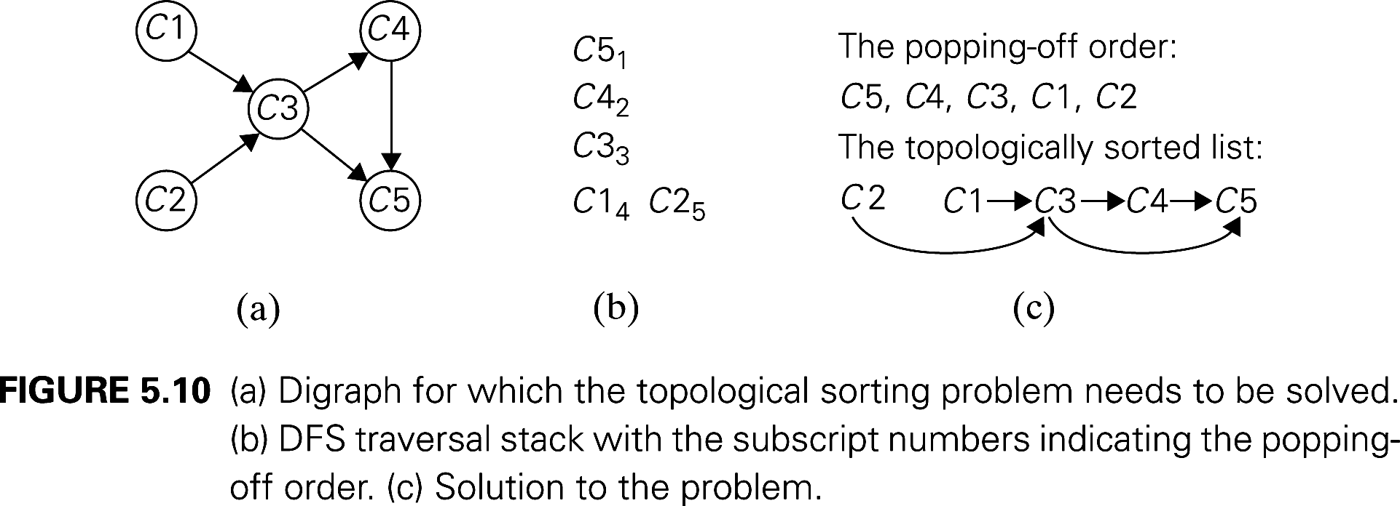
The DFS-Based Algorithm
DFS-based algorithm: (2 orderings exist in the DFS)
  DFS traversal noting the order in which vertices are popped off stack
  Reverse the above order.
Questions
  Can we use the order in which vertices are pushed onto the DFS stack (instead of the order they are popped off it) to solve the topological sorting problem?
  Does it matter from which node we start?
  Θ(|V |+|E| ) using adjacency linked lists
Notes:
Decrease and Conquer

Slide 68
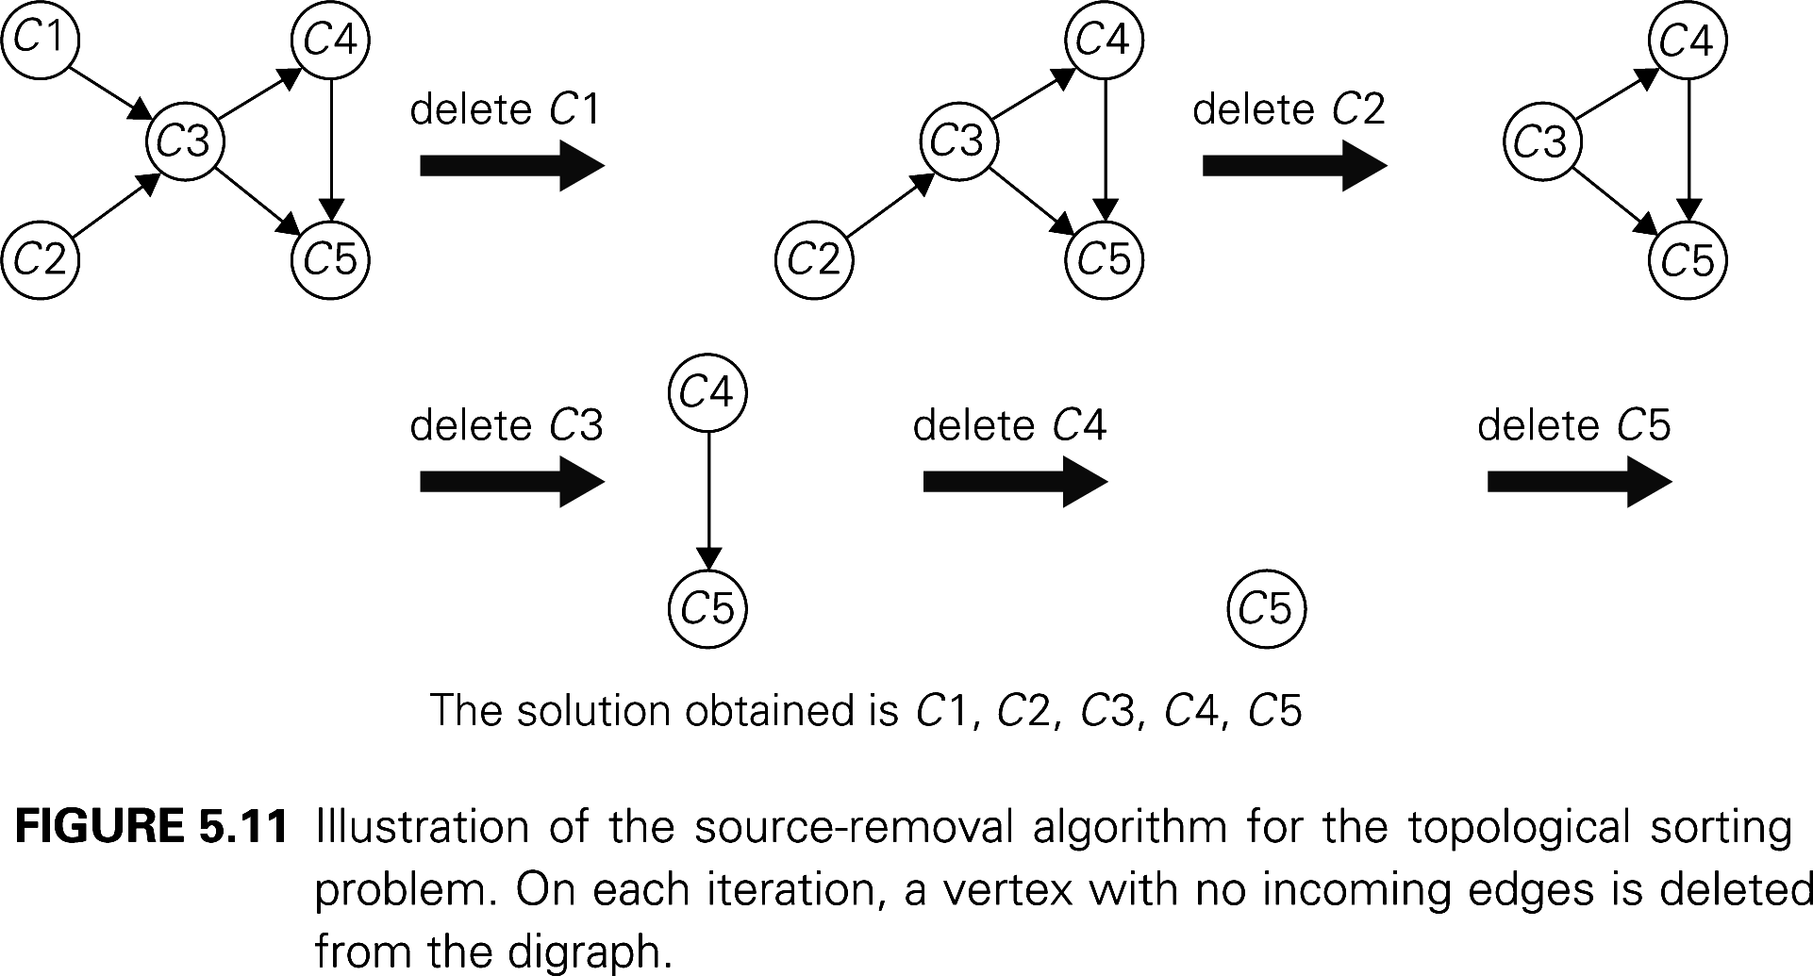
Topological sorting
p132 减一算法

Slide 69
Homework3
1. Problem 1, Exercise 5.2
2. Problem 1, Exercise 5.3
3. Problem 5, Exercise 5.3
4. Problem 3, Exercise 5.5

Slide 70
折半查找
基本思想：在有序表中，取中间记录作为比较对象，若给定值与中间记录的关键码相等，则查找成功；若给定值小于中间记录的关键码，则在中间记录的左半区继续查找；若给定值大于中间记录的关键码，则在中间记录的右半区继续查找。不断重复上述过程，直到查找成功，或所查找的区域无记录，查找失败。
k
[ r₁ … … … r_{mid-1} ] r_{mid} [ r_{mid+1} … … … r_{n} ] （mid=(1+n)/2）
如果k<r_{mid}查找这里 如果k>r_{mid}查找这里

Slide 71
例：查找值为14的记录的过程：
0 1 2 3 4 5 6 7 8 9 10 11 12 13
7 14 18 21 23 29 31 35 38 42 46 49 52
18>14
mid=7
31>14
low=1
high=13
mid=3
high=6
high=2
7<14
mid=1
low=2
14=14
mid=2

Slide 72
伪代码
折半查找算法
1. low=1；high=n； //设置初始查找区间
2. 测试查找区间［low，high］是否存在，若不存在，则查找失败；
否则
3. 取中间点mid=(low+high)/2; 比较k与r[mid]，有以下三种情况：
3.1 若k<r[mid]，则high=mid-1；查找在左半区进行，转2；
3.2 若k>r[mid]，则low=mid+1；查找在右半区进行，转2；
3.3 若k=r[mid]，则查找成功，返回记录在表中位置mid；

